Slide 1
SUPPLY CHAIN MANAGEMENT PROJECT (Group-3)
Member : 1
(Nikita Sinha)

Slide 2
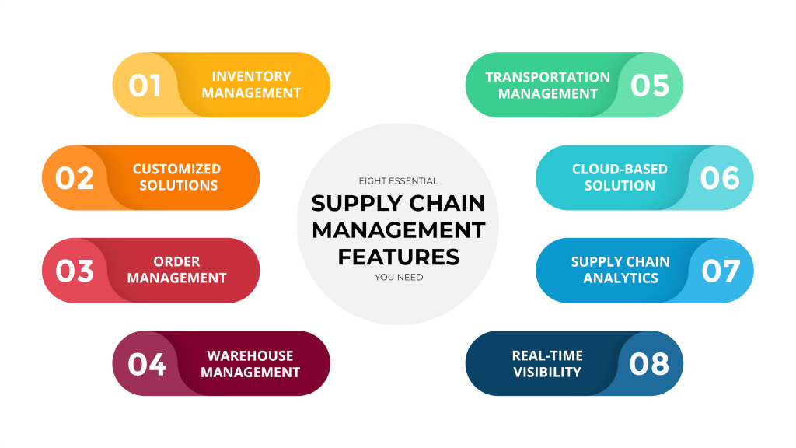
Summary of the project
Supply chain management (SCM) is the process of managing the flow of goods, services, data, and finances to and from a company. It includes the activities involved in transforming raw materials into finished products and delivering them to customers.
The goal of SCM is to improve efficiency, quality, productivity, and customer satisfaction.
Enterprise resource planning (ERP)—software that helps automate, streamline, and enhance essential business processes.
Inventory management is a key part of supply chain management that involves tracking and managing the flow of inventory from manufacturers to warehouses and to the point of sale. It's important for ensuring that the right products are available at the right time and place to meet customer demand.

Slide 3
KPI list
Key performance indicators (KPIs) in supply chain management are metrics that help evaluate the performance of a supply chain, and can help with decision-making, customer satisfaction, and product availability.
Inventory Value
Sales Amount
Total Inventory
Profit
Quantity Sold

Slide 4
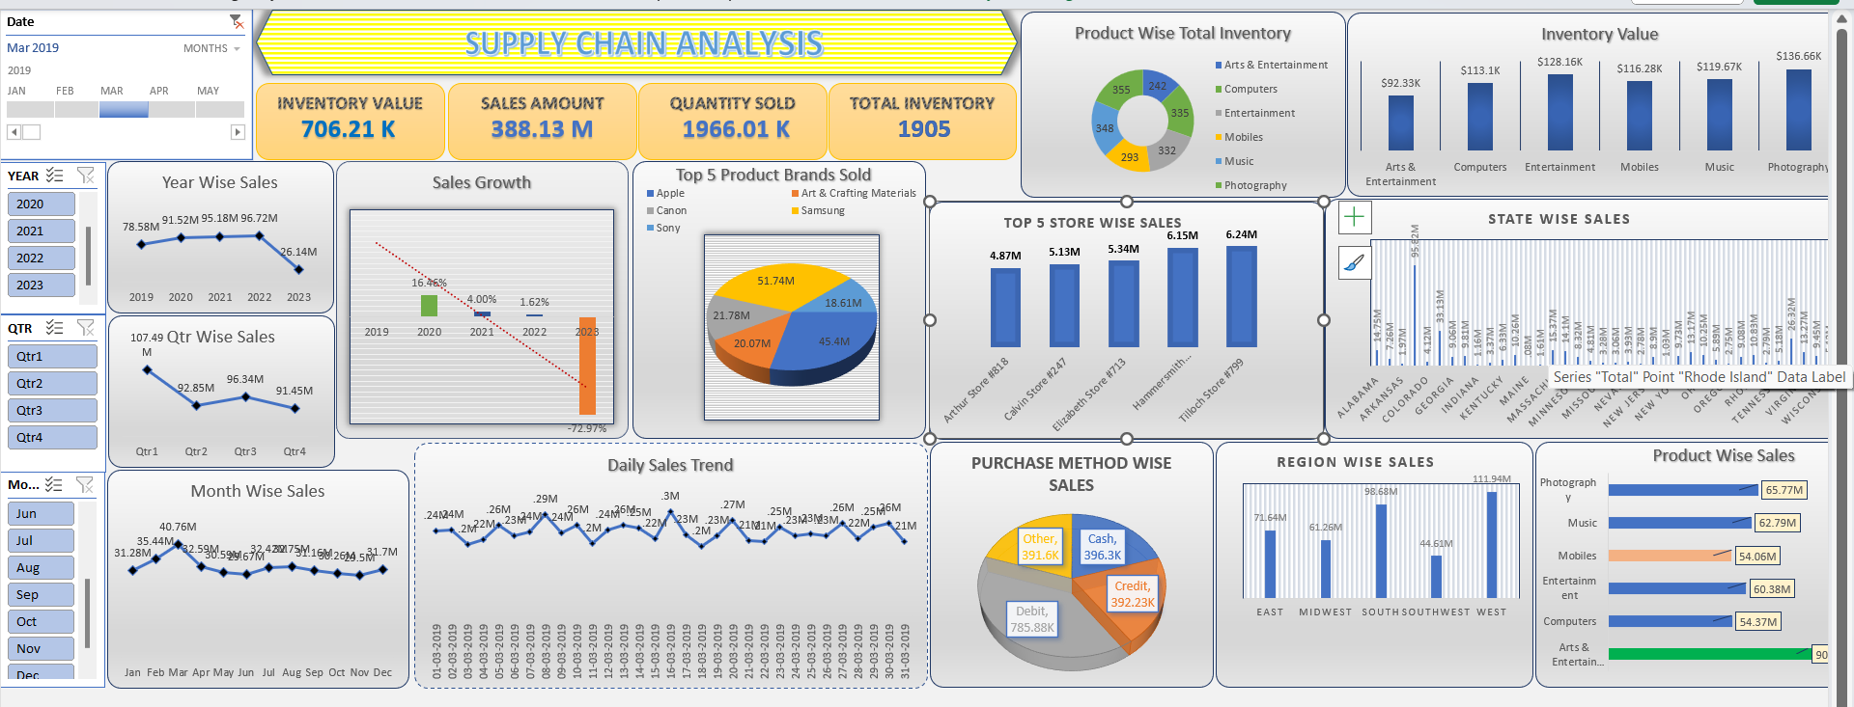
EXCEL DASHBOARD

Slide 5
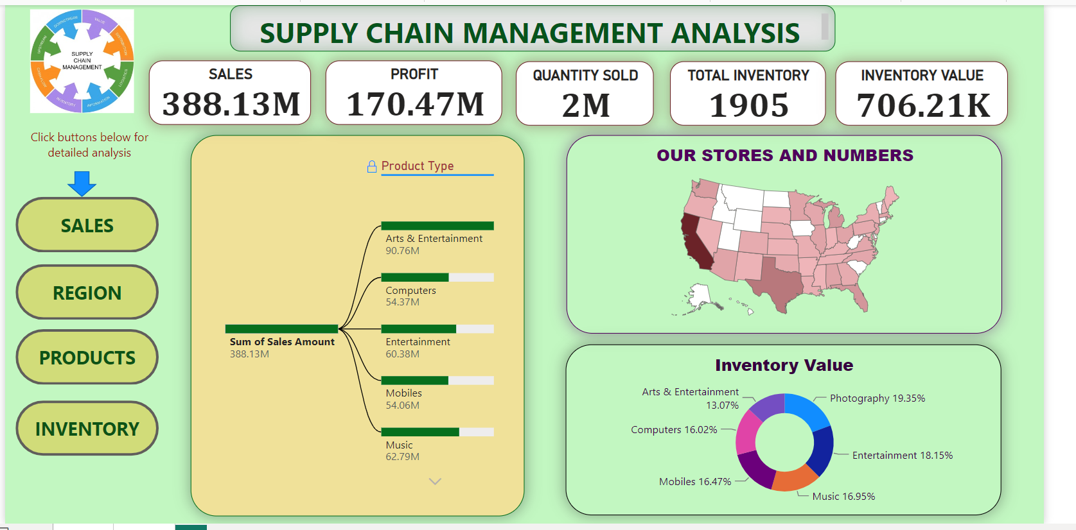
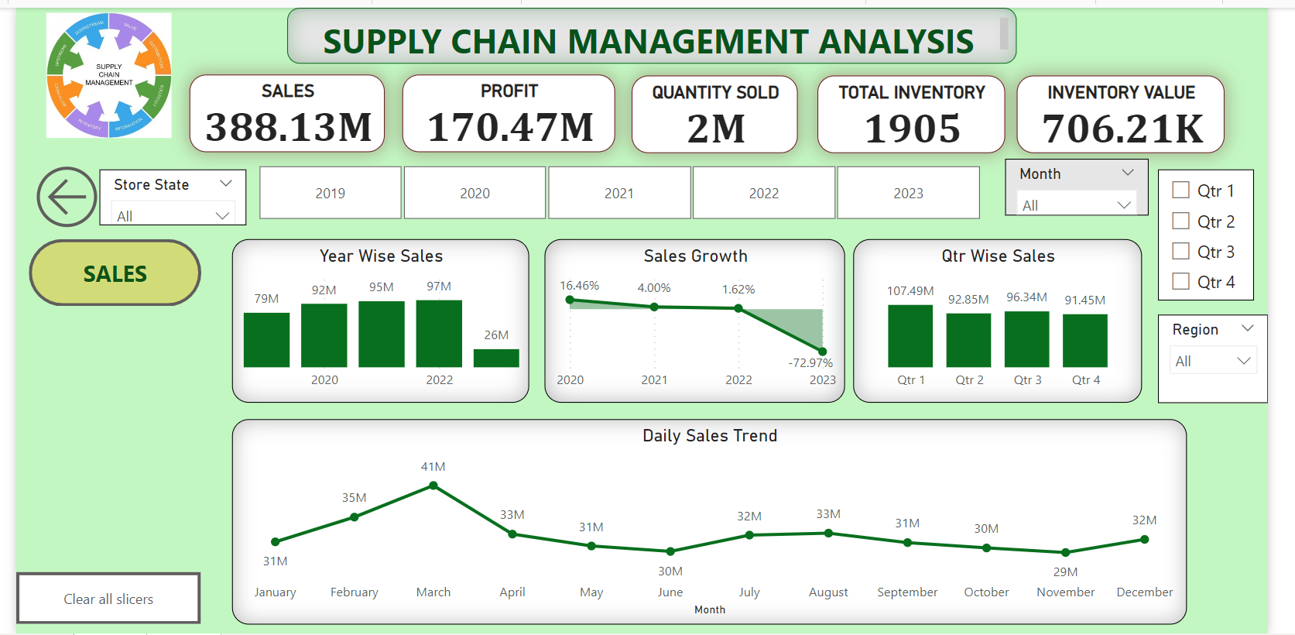
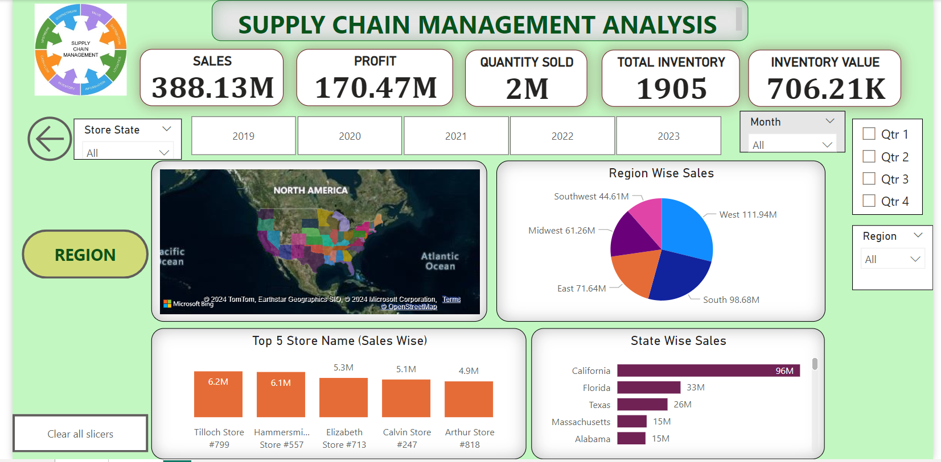
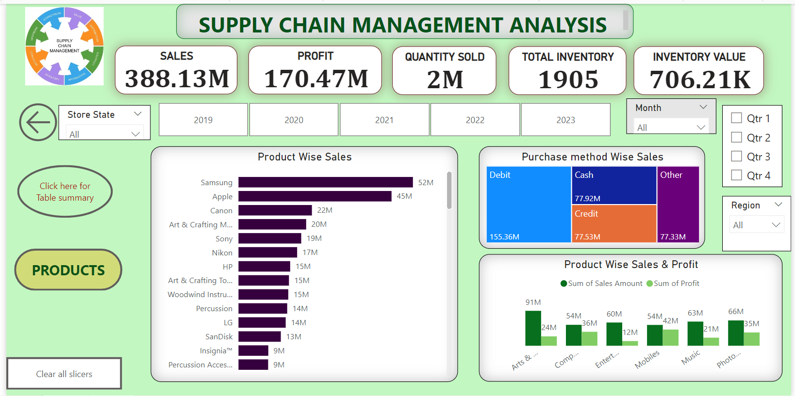
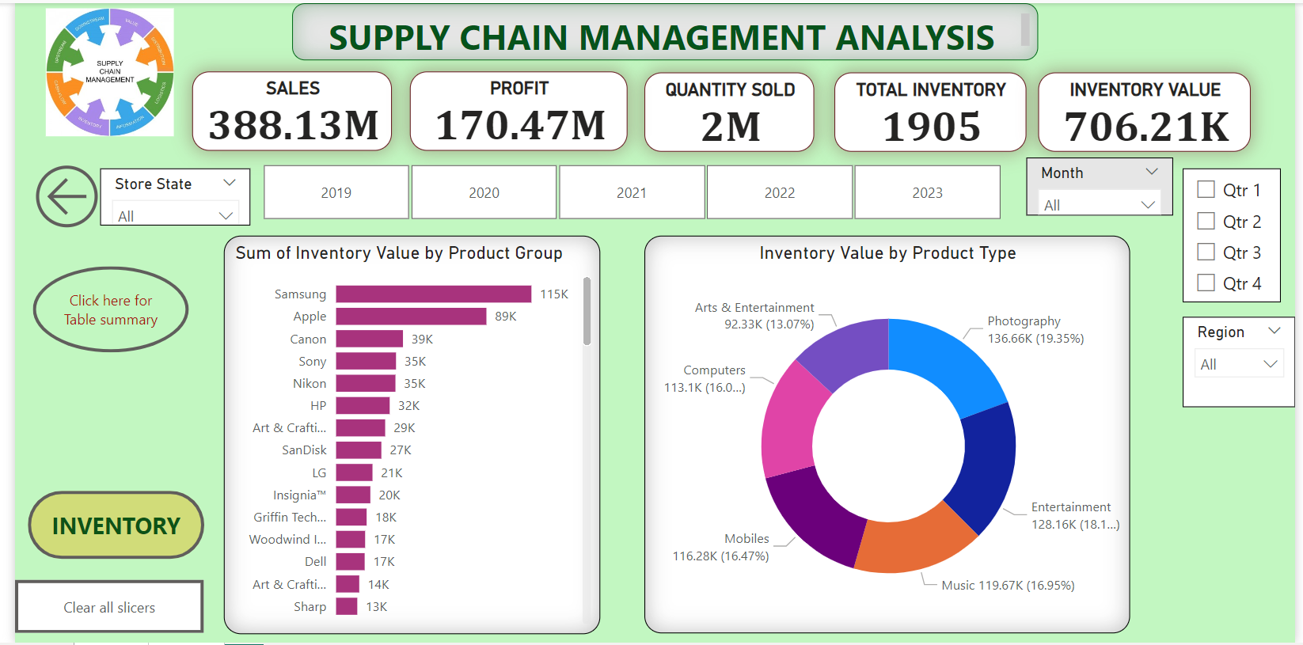
POWER BI DASHBOARD

Slide 6
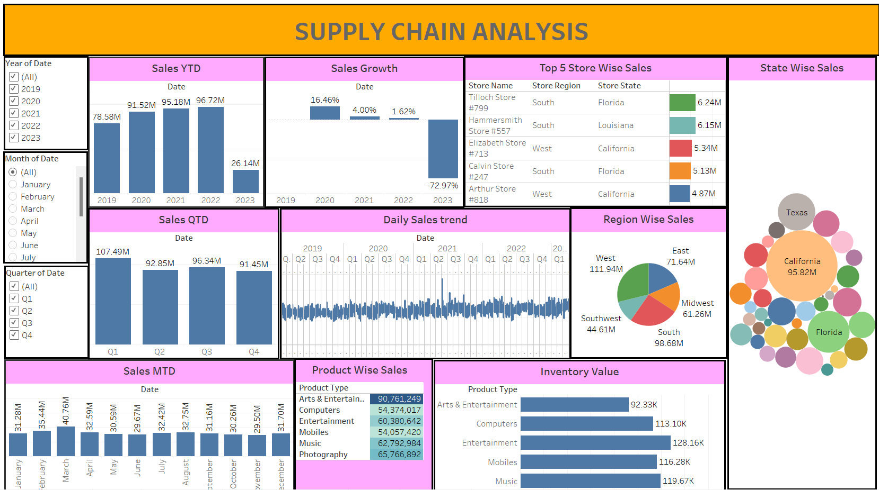
TABLEAU DASHBOARD

Slide 7
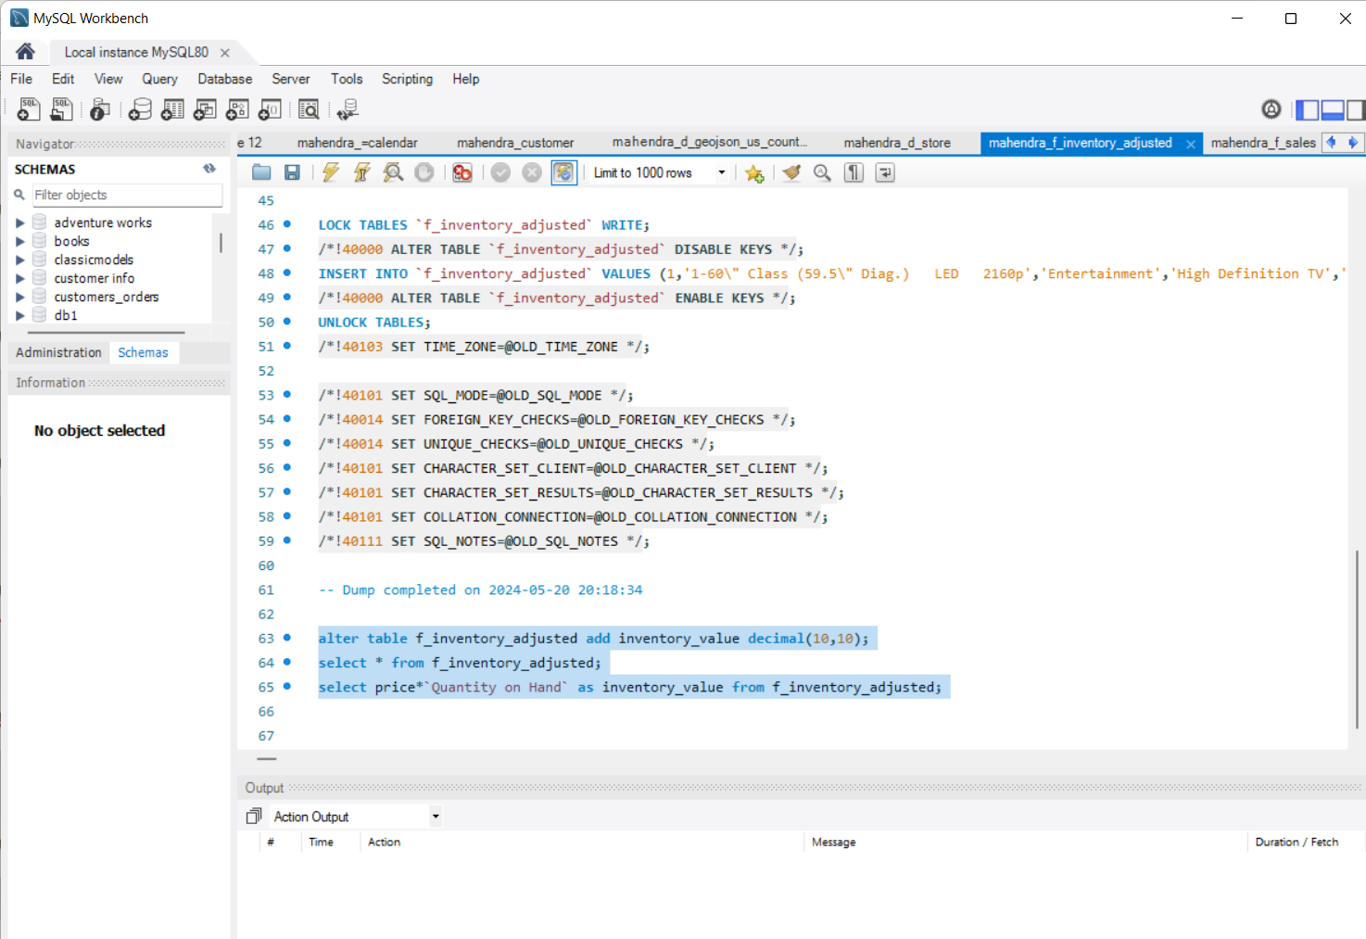
SQL Script

Slide 8
Key Takeaways:
The five most critical phases of SCM are planning, sourcing, production, distribution, and returns. A supply chain manager is tasked with controlling and reducing costs and avoiding supply shortages.
Some key takeaways from supply chain management include:
Inventory management: Ensuring the right amount of stock is available to meet customer demand.
Supplier selection: Defining specifications for raw materials and checking that they comply with regulations.
Visibility: Monitoring the supply chain in real-time to identify and respond to potential risks.
Supplier collaboration: Forming collaborative relationships with suppliers to facilitate communication and information sharing.
Demand forecasting: Accurately forecasting demand to help plan production, inventory, and transportation needs.

Slide 9
Thank you

